Slide 1
Manage an Advocacy Strategy

Slide 2
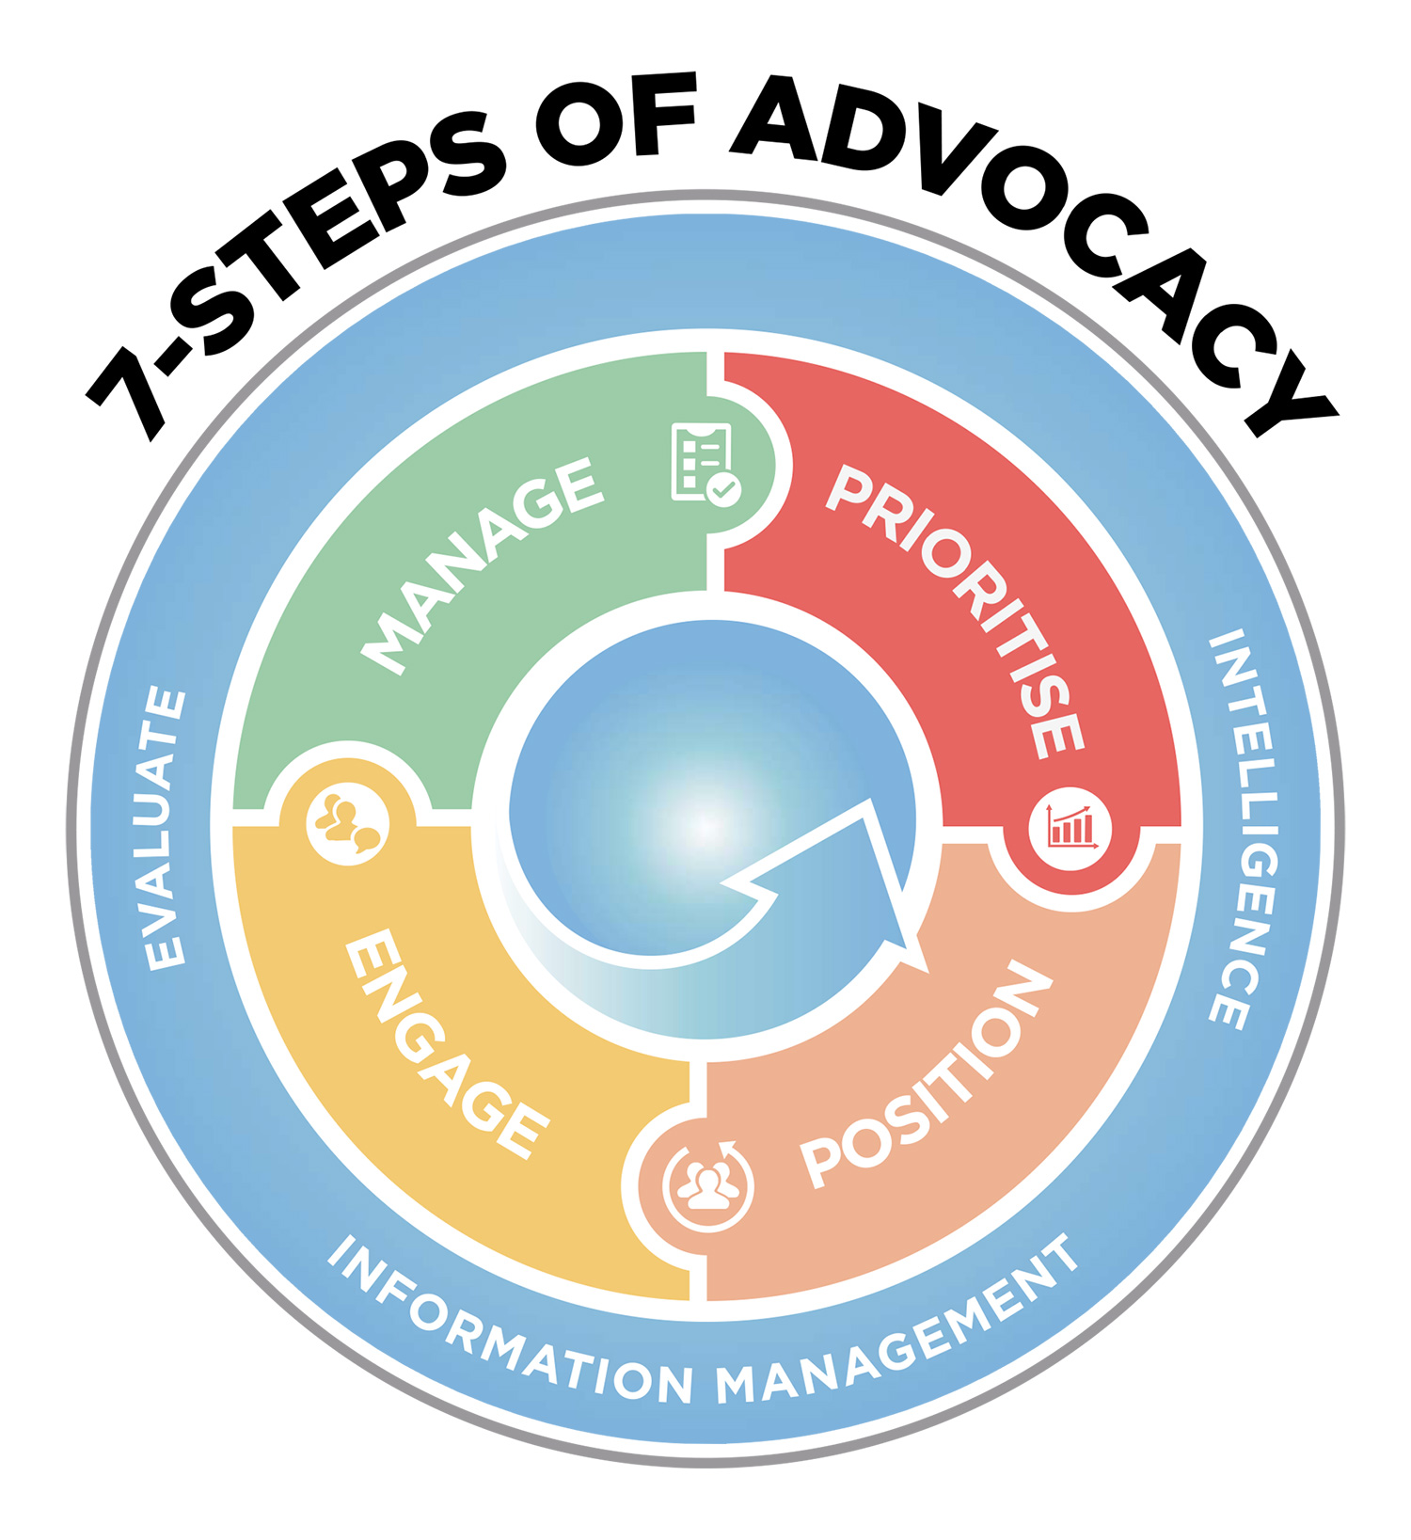
Manage all 7 Steps of Advocacy

Slide 3
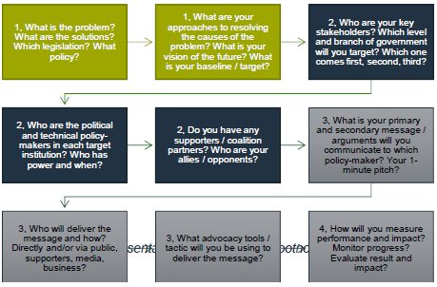
Always keep the OBJECTIVES in mind

Slide 4
Working to the External Timings & Opportunities EU Example
100%
Administrator
Rapporteur & Shadow Rapporteur
President, VP & Advisor (EP)
Leaders of political groups
MEPs
Head of Unit(s)
Director(s)
Presidency & Large MS
DG(s)
PermRep & small MS ministries
Ministries
Rapporteur & Shadow Rapporteurs
Commissioner(s) & Cabinet(s)
Presidency & large MS
Presidency & rapporteur
Drafting
1st Reading
2nd Reading
Conciliation
0%
Time

Slide 5
Have a Clear Timeline
Nov 2021
Jan 2022
Feb 2022
March 2022
April 2022
May 2022
June 2022
July 2022
August 2022
September 2022
November 2022
Dec 2021
July 2021
Oct 2021
Aug – Sept 2021
EVENT B
EVENT A

Slide 6
Pull the Key Items Together
Campaign strategy should include:
Vision, objective & arguments;
Problem and Solution analysis;
Campaign roadmap;
Stakeholder and coalition analysis;
Action plan & campaign plan
Indicators and means of measurement

Slide 7
HELICOPTER VIEW
The Issue, Position & Matrix
The Stakeholder, Timing & Coalitions
The Tools, Tactics & Strategies
Pull the Key Items Together

Slide 8
Build an Action Plan
Activity | Start & End date | Personnel | Material / Equipment | Total cost | Staff in charge | Assumptions / constraints

Slide 9
Try using a Gantt Chart

